Slide 1
Chapter Six
Capital Allocation to Risky Assets

Slide 2
Chapter Overview
Risk aversion and its estimation
Two-step process of portfolio construction
Composition of risky portfolio
Capital allocation between risky and risk-free assets
Passive strategies and the capital market line (CML)

Slide 3
Risk and Risk Aversion (1 of 2)
Speculation
Gambling
Taking considerable risk for a commensurate gain
Parties have heterogeneous expectations
Bet on an uncertain outcome for enjoyment
Parties assign the same probabilities to the possible outcomes

Slide 4
Risk and Risk Aversion (2 of 2)
Utility Values
Investors are willing to consider:
Risk-free assets
Speculative positions with positive risk premiums
Portfolio attractiveness
Increases with expected return
Decreases with risk
What happens when return increases with risk?

Slide 5
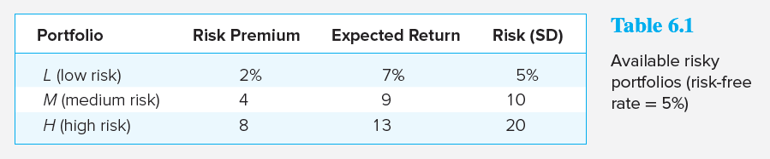
Available Risky Portfolios
Each portfolio receives a utility score to assess the investor’s risk/return trade off

Slide 6
Risk Aversion and Utility Values
Utility Function
U = Utility
E(r) = Expected return on the asset or portfolio
A = Coefficient of risk aversion
σ² = Variance of returns
½ = A scaling factor

Slide 7
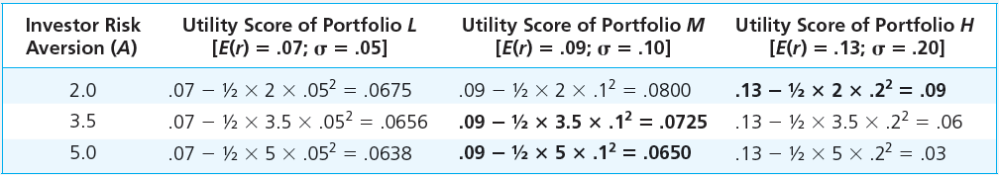
Utility Scores of Portfolios with Varying Degrees of Risk Aversion

Slide 8
Investor Types
Risk Averse Investors:
Risk-Neutral Investors:
Risk Lovers:
Where A = Coefficient of risk aversion
Notes:
Risk Averse: Rejects investment portfolios that are fair games or worse
Risk-neutral: Judges risky prospects solely by their expected returns
Risk Lover: Accepts a fair game or gamble; the investor adjusts the expected return upward to take into account the “fun” of confronting the prospect’s risk

Slide 9
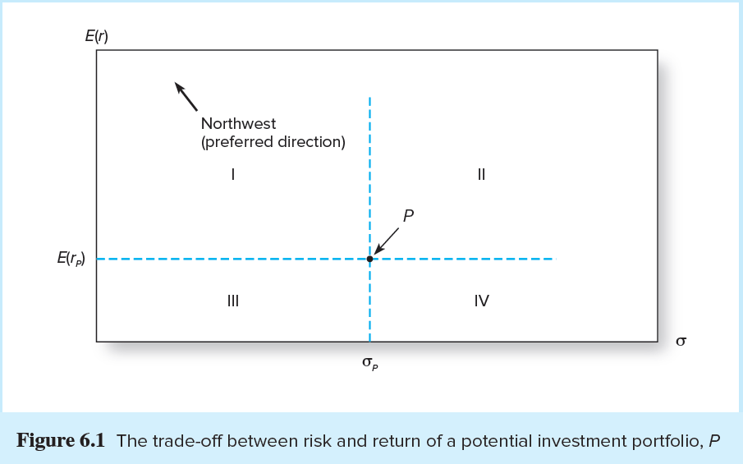
Trade-Off Between Risk and Return

Slide 10
Estimating Risk Aversion (1 of 2)
Use questionnaires
Observe individuals’ decisions when confronted with risk
Observe how much people are willing to pay to avoid risk

Slide 11
Estimating Risk Aversion (2 of 2)
Mean-Variance (M-V) Criterion
Portfolio X dominates portfolio Y if:
and
and at least one inequality is strict
Notes:
Think: Why is it necessary to have at least one inequality?

Slide 12
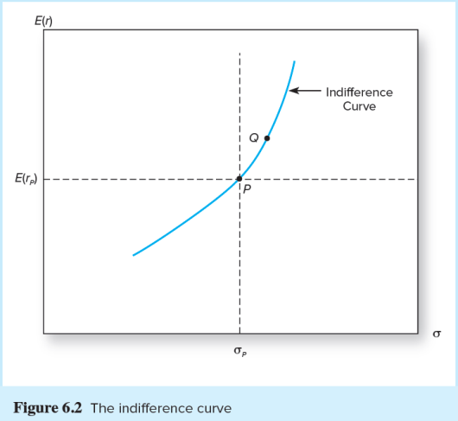
Indifference Curves
Equally preferred portfolios will lie in the mean–standard deviation plane on an indifference curve, which connects all portfolio points with the same utility value
Notes:
Think: If Portfolio X dominates Portfolio Y, where would X lie with respect to Y (and its indifference curve)?

Slide 13
Capital Allocation Across Risky and Risk-Free Portfolios
Asset Allocation:
Simplest way to control risk is to manipulate the ratio of risky assets to risk-free assets
Notes:
Asset Allocation: The choice among broad asset classes that represents a very important part of portfolio construction

Slide 14
Basic Asset Allocation Example (1 of 2)
Total market value | $300,000
Risk-free money market fund | $90,000
Equities | $113,400
Bonds (long-term) | $96,600
Total risk assets | $210,000

Slide 15
Basic Asset Allocation Example (2 of 2)
Let
y = Weight of the risky portfolio, P, in the complete portfolio
(1-y) = Weight of risk-free assets

Slide 16
The Risk-Free Asset
Only the government can issue default-free securities
A security is risk-free in real terms only if
Its price is indexed
Maturity is equal to investor’s holding period
T-bills viewed as “the” risk-free asset
Money market funds are also considered risk-free in practice

Slide 17
Portfolios: Risky Asset and Risk-Free Asset
It’s possible to create a complete portfolio by splitting investment funds between safe and risky assets
Let
y = Portion allocated to the risky portfolio, P
(1 - y) = Portion to be invested in risk-free asset, F

Slide 18
One Risky Asset and a Risk-Free Asset: Example (1 of 2)
r_{f} = 7%
E(r_{p}) = 15%
σ_{rf} = 0%
σ_{p} = 22%
The expected return on the complete portfolio:
The risk of the complete portfolio:

Slide 19
One Risky Asset and a Risk-Free Asset: Example (2 of 2)
Rearrange and substitute y = σ_{C}/σ_{P}:

Slide 20
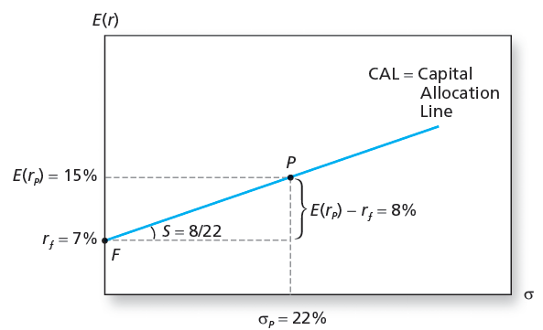
The Investment Opportunity Set

Slide 21
One Risky Asset and a Risk-Free Asset Portfolios
Capital allocation line with leverage
Lend at r_{f} = 7% and borrow at r_{f} = 9%
Lending range slope = 8/22 = 0.36
Borrowing range slope = 6/22 = 0.27
CAL kinks at P

Slide 22
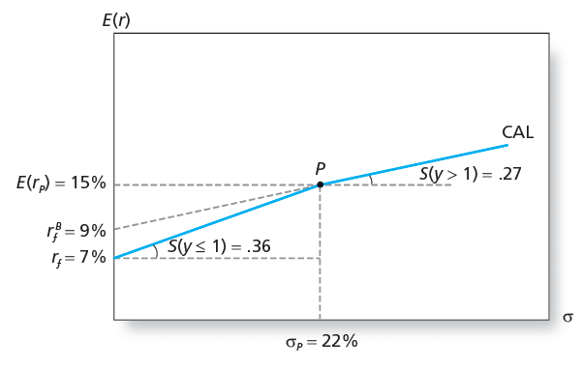
The Opportunity Set with Different Borrowing and Lending Rates

Slide 23
Risk Tolerance and Asset Allocation
The investor must choose one optimal portfolio, C, from the set of feasible choices
Expected return of the complete portfolio:
Variance:

Slide 24
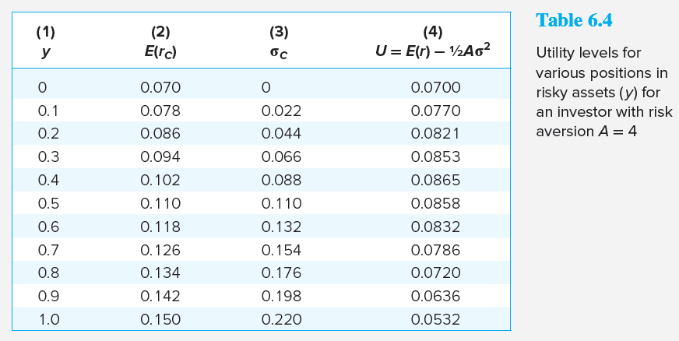
Utility Levels for Various Positions in Risky Assets

Slide 25
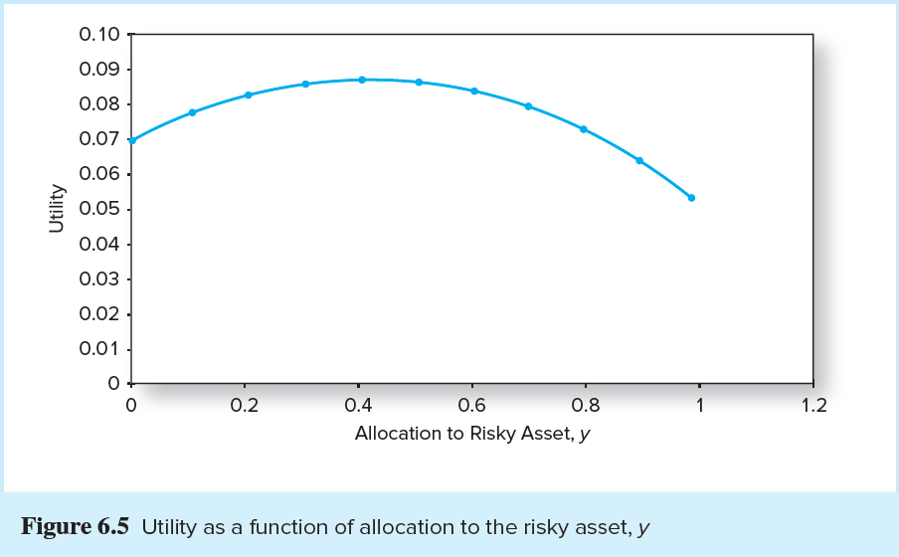
Utility as a Function of Allocation to the Risky Asset, y (1 of 2)

Slide 26
Utility as a Function of Allocation to the Risky Asset, y (2 of 2)

Slide 27
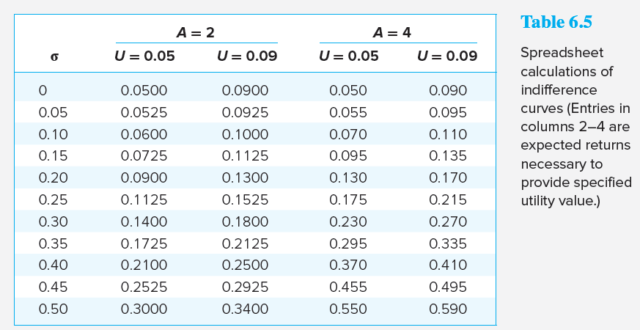
Calculations of Indifference Curves

Slide 28
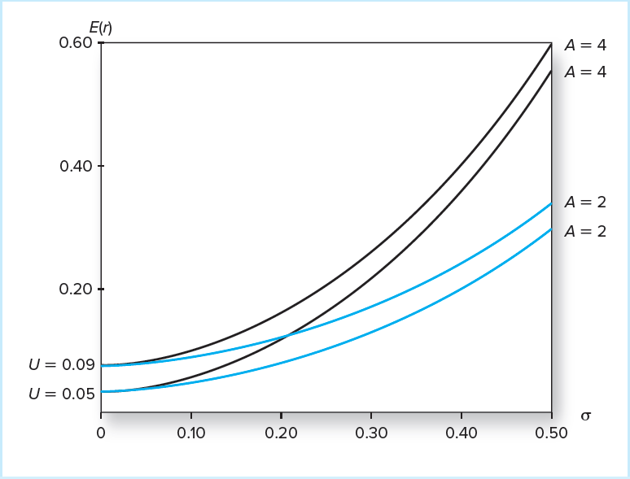
Indifference Curves for U = .05 and U = .09 with A = 2 and A = 4

Slide 29
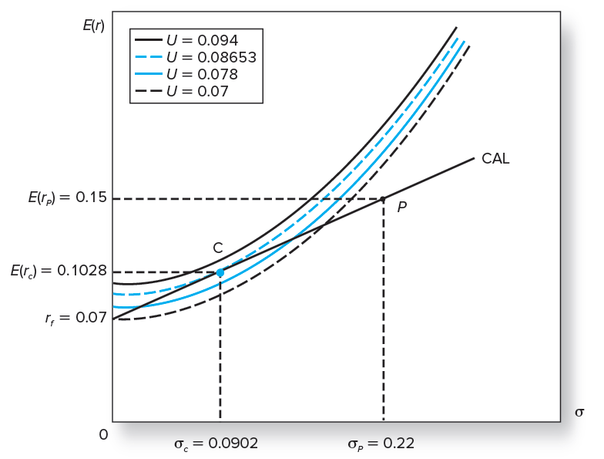
Finding the Optimal Complete Portfolio

Slide 30
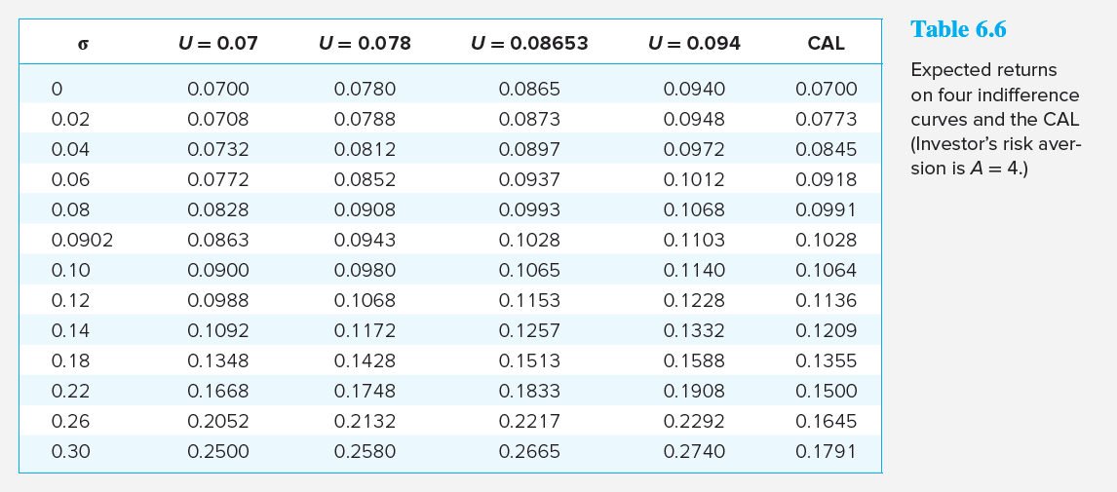
Expected Returns on Four Indifference Curves and the CAL

Slide 31
Non-Normal Returns
Above analysis implicitly assumes normality
VaR and ES* assess exposure to extreme losses
“Black swan” events should concern investors
* Discussed in Chapter 5

Slide 32
Passive Strategies: The Capital Market Line
The passive strategy avoids security analysis
Supply/demand forces may make this strategy reasonable for many investors
A natural candidate for a passively held risky asset would be the S&P 500

Slide 33
Passive Strategies: The Capital Market Line (1 of 2)
The Capital Market Line (CML)
Is a capital allocation line formed investment in two passive portfolios:
Virtually risk-free short-term T-bills (or a money market fund)
Fund of common stocks that mimics a broad market index

Slide 34
Passive Strategies: The Capital Market Line (2 of 2)
From 1926 to 2015, the passive risky portfolio offered an average risk premium of 8.3% with a standard deviation of 20.59%, resulting in a reward-to-volatility ratio of .40

